Slide 1
Business Essentials
Ebert, Griffin, Starke, Dracopoulos
8th Canadian Edition

Slide 2
CHAPTER 12
Understanding Marketing Principles and Developing Products

Slide 3

Learning Objectives
Explain the concept of marketing and describe the five forces that constitute the external marketing environment.
Explain the purpose of a marketing plan and identify the four components of the marketing mix.
Explain market segmentation and show how it is used in target marketing and positioning.
Discuss the purpose of marketing research, and compare marketing research methods.
Notes:
These learning objectives are based upon those at the beginning of the chapter. For a review of learning objectives, see the summary at the end of the chapter, as well as the list of key terms.

Slide 4
Learning Objectives
Describe the consumer buying process and the key factors that influence that process.
Discuss the three categories of organizational markets, and the characteristics of business-to-business (B2B) buying behaviour.
Explain the definition of a product as a value package and classify goods and services.
Describe the key considerations in the new product development process, and explain the importance of branding and packaging.
Notes:
These learning objectives are based upon those at the beginning of the chapter. For a review of learning objectives, see the summary at the end of the chapter, as well as the list of key terms.

Slide 5
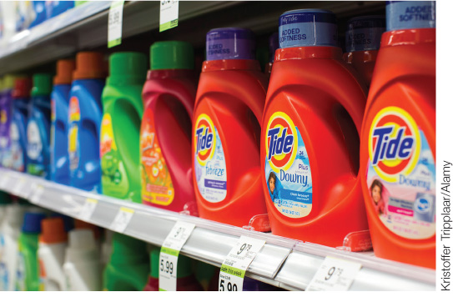

What Is Marketing?
(LO 12-1)
Marketing Concept
  the whole firm is directed toward serving customers at a profit
Delivering Value
Value = Benefits/Costs
Utility: adding value
Time Utility
Place Utility
Ownership (Possession) Utility
Form Utility
Notes:
3
3
Learning Objective: 12-1
Page(s): 293
Notes:
Form utility. Marketing has a voice in designing products with features that customers want.
Time utility. Marketing creates a time utility by providing products when customers will want them.
• Place utility. Marketing creates a place utility by providing products where customers will want them.
• Possession utility. Marketing creates a possession utility by transferring product ownership to customers by setting selling prices, setting terms for customer credit payments, if needed, and providing ownership documents.

Slide 6
What Is Marketing?
(LO 12-1)
Goods, Services, and Ideas
Marketing can be designed for:
  consumer goods: tangible products purchased by individuals for their use
  industrial goods: products purchased by companies to use directly or indirectly to produce other products
  services: intangible products to serve users’ needs
  ideas: thoughts or philosophies
Notes:
4
4
4
4
4
Learning Objective: 12-1
Page(s): 293

Slide 7
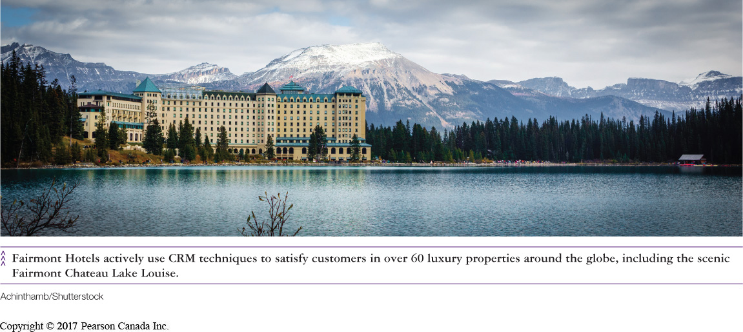
What Is Marketing?
(LO 12-1)
Relationship Marketing
  building lasting relationships with customers and suppliers
    (Goal: customer satisfaction and retention)
Customer Relationship Marketing (CRM)
  organized methods used to build information connections to improve company–client relationships
Notes:
4
4
4
4
4
Learning Objective: 12-1
Page(s): 294

Slide 8
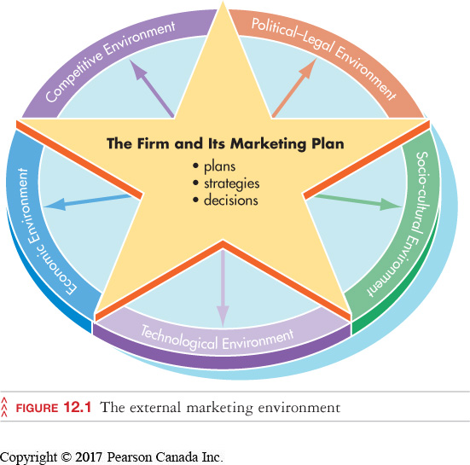
What Is Marketing?
(LO 12-1)
The Marketing Environment
Notes:
5
5
5
5
5
Learning Objective: 12-1
Page(s): 295
Figure 12.1
Notes
The external environment is made up of factors external to the firm that influence its marketing program by posing opportunities and threats. The firm’s marketing plans, its decisions and strategies are determined only after carefully analyzing the external environment and its impact on the options open to the firm.

Slide 9
What Is Marketing?
(LO 12-1)
Political and Legal Environment
  legislation and government programs can be favourable or not
  marketing managers try to maintain favour by:
gaining public support for products
lobbying and contributing to political parties (within restrictions)
advertising for public awareness of important issues
Notes:
6
6
6
6
6
Learning Objective: 12-1
Page(s): 283

Slide 10
What Is Marketing?
(LO 12-1)
Social and Cultural Environment
  reflects the values, beliefs, and ideas of a society
    growing popularity of organic food
Economic Environment
  conditions affect spending patterns of businesses and individuals
  trends affect price strategy and the growth of markets (domestic & global)
the Canadian dollar
inflation/deflation
interest rates
business cycle
Notes:
Learning Objective: 12-1
Page(s): 295-296
Figure 12.1
Notes
Changes in social and cultural practices lead to the death of some products and the birth of others. Changes in lifestyle create need for some products over others leading to market growth (such as the growth of the fitness industry as the population ages and becomes more health conscious).

Slide 11

What Is Marketing?
(LO 12-1)
Technological Environment
  science and technology lead to new ways of doing everyday things
new goods continue to emerge (like tablets and smart phones)
trends create new goods and cause others to become obsolete
Notes:
8
8
8
8
8
Learning Objective: 12-1
Page(s): 295-296
Figure 12.1
Notes
Technology affects the kinds of products offered, how they are distributed, and promoted. It now possible to advertise services over the world wide web.

Slide 12
What Is Marketing?
(LO 12-1)
Competitive Environment
Brand Competition
  similar products (Coke vs. Pepsi)
Substitute Products
  dissimilar products that can meet the same need (juice vs. Pepsi)
International Competition
  marketing domestic products against foreign products (Ford vs. Honda)
Notes:
10
10
10
10
10
Learning Objective: 12-1
Page(s): 296
Figure 12.1

Slide 13
Strategy: The Marketing Mix
(LO 12-2)
Marketing Plan
  a detailed, focused strategy for gearing the marketing mix to meet consumer needs and wants
Product
Price
Marketing
Mix
Place
Promotion
Notes:
11
11
11
11
11
Learning Objective: 12-2
Page(s): 296-298
Notes
The company must first identify a consumer group, then develop a plan to serve it. Marketing managers are responsible for planning and implementing all the marketing mix activities that result in the transfer of goods or services to customers. Marketing planning may begin years before the plan is to be implemented. Care must be taken to collect sufficient market and customer data to direct the planning process. Goals and objectives must be created to direct the plan and evaluate its results.

Slide 14
Strategy: The Marketing Mix
(LO 12-2)
Product
  offering a good, service, or idea that satisfies buyers’ needs
Product Differentiation
  creating a product that has a different image than existing products to attract consumers
  changing existing products by responding to trends or improving current offerings
Notes:
15
15
15
15
15
Learning Objective: 12-2
Page(s): 296-298

Slide 15
Strategy: The Marketing Mix
(LO 12-2)
Price
  choosing the right price to attract consumers & meet profit goals
    may be a low-price strategy or high-price strategy
    price must consider all costs
Place (Distribution)
  getting the product from producer to buyer
    physical transportation, warehousing, inventory
    choice of sales outlets
Notes:
16
16
16
16
16
Learning Objective: 12-2
Page(s): 296-298

Slide 16
Strategy: The Marketing Mix
(LO 12-2)
Promotion
  choosing the right method of communicating information about the product
advertising
personal selling
sales promotions
public relations
Direct or Interactive Marketing
Notes:
18
18
18
18
18
Learning Objective: 12-2
Page(s): 296-298
Notes
Promotion is the most visible part of the promotional program. Product positioning also overlaps into product strategy and market segmentation. Product positioning is the process of adapting the product to meet the needs of consumers.

Slide 17
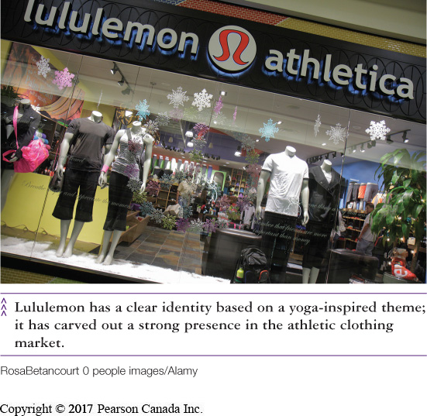
Target Marketing and Market Segmentation
(LO 12-3)
Target market
  a group of potential customers who have similar wants and needs
Segmentation
  dividing a consumer market into categories
  selecting specific market segment(s) to pursue positioning
Notes:
25
25
25
25
25
Learning Objective: 12-3
Page(s): 298-300

Slide 18
Target Marketing and Market Segmentation
(LO 12-3)
Market Segmentation
  search for common traits between consumers
  focus on traits that affect product need or purchase behaviour
Geographics
Demographics
Geo-Demographic
Psychographics
Behavioural Variables
Notes:
Learning Objective: 12-3
Page(s): 298-300

Slide 19
Target Marketing and Market Segmentation
(LO 12-3)
Geographic Variables
  area of residence affects product consumption
Geo-Demographic Variables
  a combination of geographic and demographic traits
Rainfall
  Umbrellas
Snowfall
  Snowmobiles
  Snow blowers
Hot Summers
  Backyard pools
    Young Urban Professionals—well educated, 25- to 34-year-olds with high-paying jobs living in the “downtown” core of major cities.
Notes:
27
27
27
27
27
Learning Objective: 12-3
Page(s): 298-300

Slide 20
Target Marketing and Market Segmentation
(LO 12-3)
Demographic Variables
Age
Income
Family Size
Ethnicity
Religion
Education
Marital Status
Gender
Occupation
Language
Notes:
28
28
28
28
28
Learning Objective: 12-3
Page(s): 298-300
Table 12.1

Slide 21

Target Marketing and Market Segmentation
(LO 12-3)
Psychographic Variables
  consumer characteristics that may be considered in developing a segmentation strategy
lifestyles
opinions
interests
attitudes
Notes:
29
29
29
29
29
Learning Objective: 12-3
Page(s): 298-300
Table 12.1
Notes
Probing psychological orientations and consumer motivations can explain why two people with the same demographic characteristics react very differently when choosing products. Psychographic characteristics can be influenced by marketing campaigns (e.g., opinions, lifestyle activities).

Slide 22
Target Marketing and Market Segmentation
(LO 12-3)
Behavioural segmentation
  dividing a market into groups based on consumer knowledge, use, or response to a product
Behavioural Variables
benefits sought
usage rate
occasion for use
loyalty status
user status
Notes:
30
30
30
30
30
Learning Objective: 12-3
Page(s): 298-300
Notes
Market segmentation must be done carefully. For instance, ethnicity, values adoption process are factors to be considered when deciding how to market a product.

Slide 23
Target Marketing and Market Segmentation
(LO 12-3)
Positioning
  the process of fixing, adapting, and communicating the nature of the product itself
  the place a product occupies in a consumer’s mind
Notes:
30
30
30
30
30
Learning Objective: 12-3
Page(s): 298-300

Slide 24

Market Research
(LO 12-4)
Market Research
  systematic study of consumer needs
  focuses on the marketing-mix elements
  leads to more effective marketing; increases the accuracy and effectiveness of segmentation
Notes:
31
31
31
31
31
Learning Objective: 12-4
Page(s): 300-301

Slide 25
Market Research
(LO 12-4)
The Research Process
  Study the Current Situation
  Select a Research Method
    focus group
    survey
    observation
    experimentation
  Collect Data
    use secondary data
    use primary data
  Analyze Data
  Prepare Report
    make recommendations
Notes:
32
32
32
32
32
Learning Objective: 12-4
Page(s): 300-301
Notes
This process is a systematic and carefully planned approach designed to diagnose the research needs of the firm and fulfill them in the most accurate and cost-effective means open to the firm.

Slide 26
Understanding Consumer Behaviour
(LO 12-5)
The study of the process by which customers come to purchase and consume a product or service
Influenced by:
psychological factors
personal factors
social factors
cultural factors
Notes:
37
37
37
37
37
Learning Objective: 12-5
Page(s): 301-303
Notes
Some examples of influential factors affecting consumer behaviour include:
- Psychological: motivations, perceptions, ability to learn, attitudes
- Personal: lifestyle, personality, economic status, life-cycle stage
- Social: family, opinion leaders, reference groups
- Cultural (the way of living that distinguishes one group from another): social class

Slide 27
Understanding Consumer Behaviour
(LO 12-5)
The Consumer Buying Process
Problem/need recognition
Information seeking
Evaluation of alternatives
Purchase decision
Post-purchase evaluation
Notes:
39
39
39
39
39
Learning Objective: 12-5
Page(s): 301-303
Notes
The purchase process is affected by the marketing strategy of the firm (marketing mix) as well as the factors affecting consumers on a personal level.
Purchase anxiety (buyer’s remorse) is fear on the part of purchasers that they have purchased the wrong product (especially crucial for expensive purchases).

Slide 28
Organizational Marketing and Buying Behaviour (LO 12-6)
Organizational Markets
  organizations purchase goods and services to be used in the production of other goods and services
industrial market
reseller market
government and institutional market
Notes:
44
44
44
44
44
Learning Objective: 12-6
Page(s): 303-304

Slide 29
Organizational Marketing and Buying Behaviour (LO 12-6)
Organizational Buying Behaviour
  differences in buyers
    professionals
    specialists
    experts
Differences in the buyer–seller relationship
  emphasize personal selling by trained representatives who understand the needs of each customer
Notes:
45
45
45
45
45
Learning Objective: 12-6
Page(s): 303-304

Slide 30
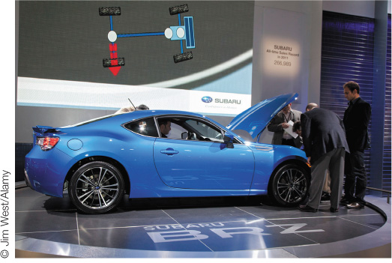
What Is a Product?
(LO 12-7)
Product Features and Benefits
  consumers purchase a product for its function and benefit to them
    features include tangibles and intangibles (like image and reputation)
    benefits are the results of the features
    value package: a bundle of value-adding attributes, including reasonable cost
Notes:
4
4
4
Learning Objective: 12-7
Page(s): 304-305

Slide 31
What Is a Product?
(LO 12-7)
Consumer Products
Shopping goods and services
Convenience goods and services
Specialty goods
Industrial Products
Production items
Expense items
Capital items
Notes:
5
5
5
Learning Objective: 12-7
Page(s): 304-305
Notes
While there are typical examples of products for each classification, a product can fall into any group depending on how the consumer goes about the purchase process.
Convenience goods and services are used regularly and relatively inexpensive. (milk, newspapers, fast food)
Shopping goods and services are bought less frequently, may cost more and consumers often compare brands. (electronics, insurance)
Specialty goods and services are more expensive, and consumers have strong preferences and will accept no substitutes. (wedding dresses, catering)
EXPENSE ITEM An industrial product purchased and consumed within a year by firms producing other products.
CAPITAL ITEM An expensive, long-lasting, infrequently purchased industrial product, such as a building, or an industrial service, such as a long-term agreement for data warehousing services.
PRODUCTION ITEM An industrial product purchased and used directly in the production process that creates other goods or services.

Slide 32

What Is a Product?
(LO 12-7)
Product mix
  the group of products a company has for sale
Product line
  a group of similar products intended for a similar group of buyers
Notes:
10
10
10
Learning Objective: 12-7
Page(s): 304-305

Slide 33

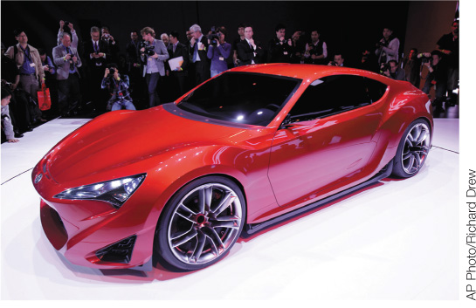
Developing New Products
(LO 12-8)
New Product Development
  needed to expand, and survive
  expensive, risky, and long time horizons
  product mortality; only 1 in 50 new product ideas reaches the market
  speed to market
    must introduce products quickly to respond to changes
Pepsi Blue was a classic product failure
Notes:
Learning Objective: 12-8
Page(s): 305-307

Slide 34
Developing New Products
(LO 12-8)
Step #1: Product ideas
Step #2: Screening
Step #3: Concept testing
Step #4: Business analysis
Step #5: Prototype development
Step #6: Product and market testing
Step #7: Commercialization
Notes:
Learning Objective: 12-8
Page(s): 305-307
Activities
Using examples of products which exist, ask students to trace the product development process. Why do some products fail? Engage students in a discussion about how such product failures could be avoided. Can there ever be a foolproof approach to product development?

Slide 35
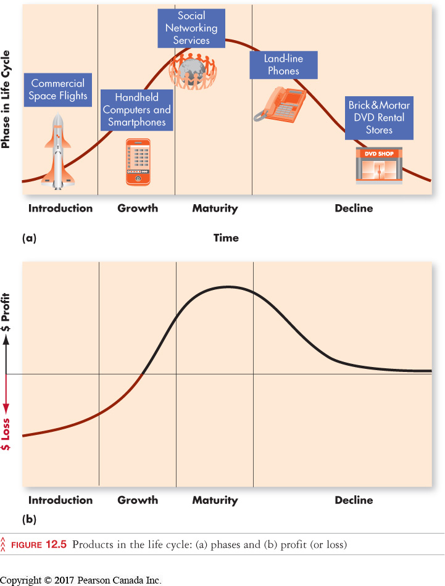
Developing New Products
(LO 12-8)
Product Life Cycle
  products have a limited profit-producing life cycle
  may be months, years, or decades
Notes:
22
22
22
Learning Objective: 12-8
Page(s): 307-309

Slide 36
Developing New Products
(LO 12-8)
Extending Product Life: An Alternative to New Products
Product Extension
  product marketed globally
Product Adaptation
  product modified to appeal to foreign markets
Reintroduction
  reviving old products for new markets
Notes:
Learning Objective: 12-8
Page(s): 307-309
Note
Using foreign markets is just one possibility for trying to stretch out the maturity phase of a product.

Slide 37
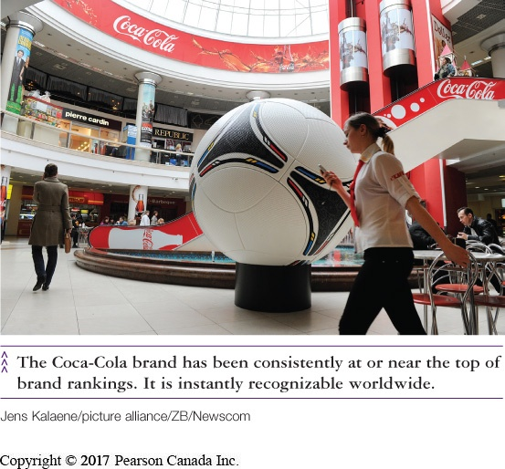
Identifying Products
(LO 12-8)
  Branding
    use of symbols to communicate the qualities of a product made by a producer
  Brand Equity
    added value a brand provides to a product beyond its basic functional benefits
Notes:
29
29
29
Learning Objective: 12-8
Page(s): 309-310

Slide 38
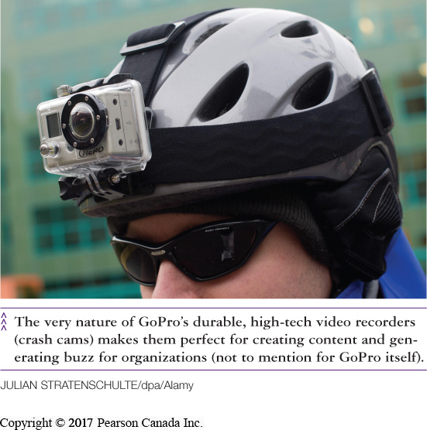
Identifying Products
(LO 12-8)
  Gaining Brand Awareness
    Product Placements
    Buzz Marketing
    Viral Marketing & Social Networking
Notes:
29
29
29
Learning Objective: 12-8
Page(s): 309-310

Slide 39
Identifying Products
(LO 12-8)
Types of Brand Names
National
  distributed by, and carrying the name of the manufacturer
    (e.g., Kellogg’s)
Private
  brands carrying the name of the retailer or wholesaler
    (e.g., President’s Choice)
Generic
  house-brand sold under the category name rather than a specific company name
Notes:
Learning Objective: 12-8
Page(s): 309-310
Notes
The brand identifies the product from others in the marketplace. Consumers may become loyal to a brand.
Activities
Brainstorm in class with students to list as many brands as you can. Then, classify them as national and/or licensed, private or generic.

Slide 40
Identifying Products
(LO 12-8)
Types of Brand Names
Packaging
  the physical container
Labelling
  identifies the name, contents, and possibly benefits
  must conform to Consumer Packaging and Labelling Act
Licensed
  selling the right to use the firm’s name on another company’s product
  e.g., Harley-Davidson, Disney characters
Notes:
Learning Objective: 12-8
Page(s): 309-310
Notes
The brand identifies the product from others in the marketplace. Consumers may become loyal to a brand.
Activities
Brainstorm in class with students to list as many brands as you can. Then, classify them as national and/or licensed, private or generic.

Slide 41
QUICK-CHECK QUESTIONS
1) In setting marketing strategy, for consumer goods, organizations must look at internal as well as external factors. Which of the following represents one of the important external factors in the marketing environment?
A) Branding environment
B) Technological environment
C) Geo-Demographic environment
D) B2B environment
Answer:
B) Technological environment

Slide 42
QUICK-CHECK QUESTIONS
2) Automobile companies like Hyundai and Kia are winning entry-level customers with high quality vehicles, comprehensive warranties and reasonable financing options. They have targeted their marketing efforts specifically on young drivers. They have effectively segmented the market based on:
A) geographic variables
B) product-use variables
C) psychographic variables
D) demographic variables
Answer:
D) demographic variables

Slide 43
QUICK-CHECK QUESTIONS
3) When Simone was in the process of buying a new car she visited a Honda dealership as well as a Scion and GM dealership to test drive her top three options. Simone was in the _________ stage of the buying decision process.
A) evaluation of alternatives
B) purchase decision
C) information seeking
D) post-purchase evaluation
Answer:
A) evaluation of alternatives

Slide 44
QUICK-CHECK QUESTIONS
4) Rolex and Timex watches both do a good job of telling the time, but Rolex marketers understand that their customers will pay high prices for the status and reputation that accompanies a Rolex watch. This illustrates _________.
A) specialty goods criteria
B) the value package
C) expense items factor
D) licensed brand criteria
Answer:
B) the value package

Slide 45
QUICK-CHECK QUESTIONS
5) You have determined that an idea for a new product has profit potential. Using the Seven-Step Development Process, what should you do next?
A) Develop a prototype
B) Sell the product in a test market
C) Conduct focus groups
D) Analyze the product’s life cycle
Answer:
A) Develop a prototype

